Slide 1

McDonalds : AI-Powered Business Strategy Analyst
A Retrieval-Augmented Generation (RAG) System for McDonald's India.
BUILT WITH GROQ (LLAMA 3.1)
CHROMA VECTOR DB
STREAMLIT

Slide 2

Project Overview
Core Objective
Mission
This RAG system retrieves relevant business insights from corporate documents, generates structured strategic recommendations, provides measurable KPIs, and ensures grounded, context-based outputs.
Deliver data-driven strategic insights for McDonald's India using AI.

Slide 3
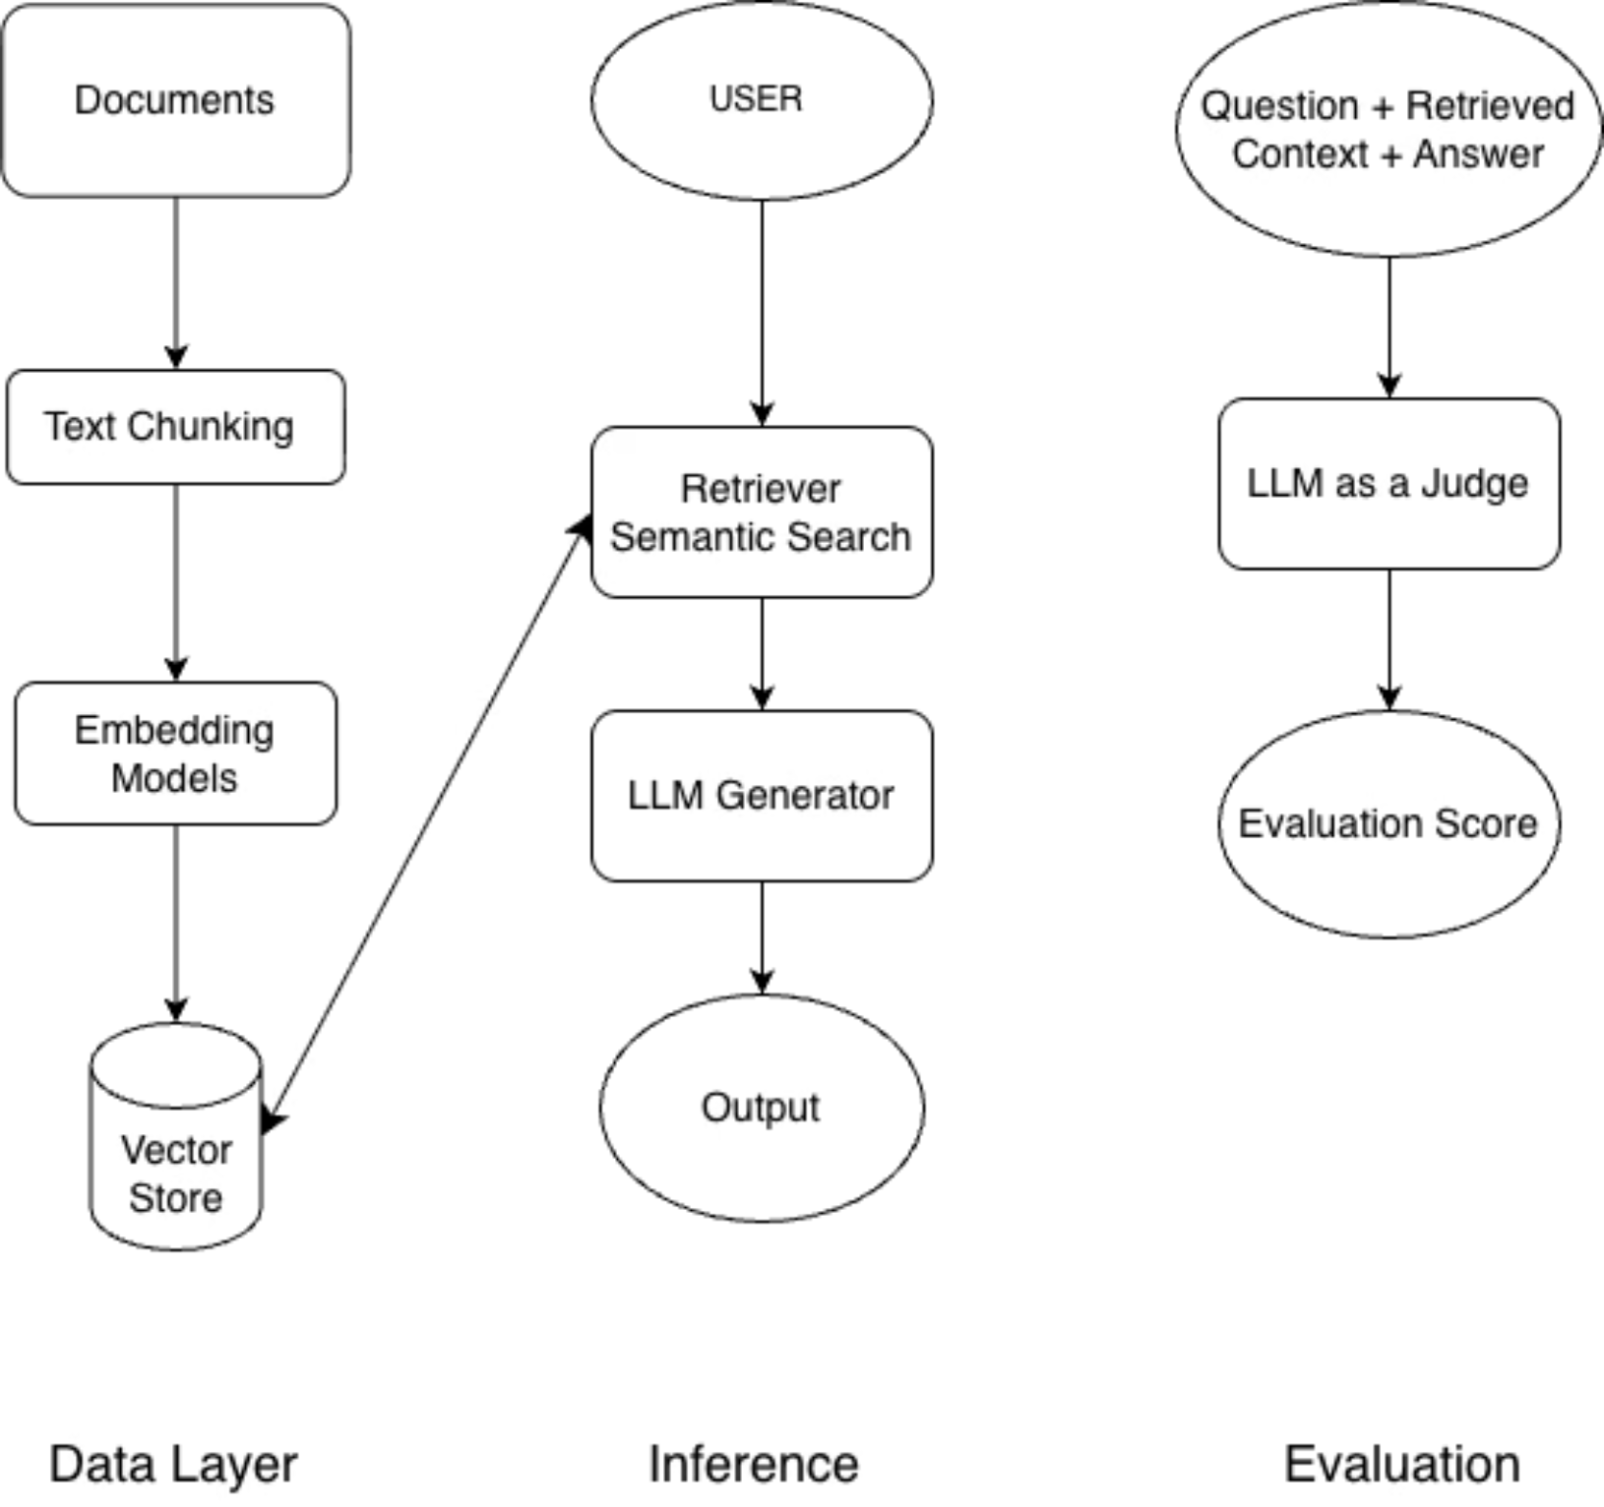
System Architecture

Slide 4
Model Selection Strategy
Evaluation Criteria
LLM (70B)
SLM (8B)
Hybrid Approach
Reasoning Depth
Excellent
Good
Generator: Llama 3.1-8B for rapid inference and real-time responsiveness
Judge: Llama 3.1-70B for robust reasoning and quality assessment
Cross-Document Analysis
Superior
Moderate
This configuration balances performance with strategic depth, optimising both speed and accuracy.
Hallucination Control
Strong
Requires Tuning
Strategic Output Quality
High
Adequate
Inference Speed
Slower
Fast
According to our needs for recommending strategy, LLM (8B) solves our purpose well.

Slide 5

Prompt Engineering Strategy
Context-Only Instruction
Structured Output Format
Strict adherence to retrieved documents prevents hallucination and ensures every insight is traceable to source material.
Responses follow a consistent framework: Strategic Insight, Recommended Initiatives, and measurable KPIs for tracking success.
Business-Focused Language
Domain Adaptation
Eliminates generic consulting jargon in favour of specific, actionable business reasoning tailored to McDonald's India operations.
Prompts incorporate QSR industry terminology and McDonald's strategic priorities to enhance relevance and applicability.

Slide 6


LLM-as-a-Judge Evaluation
Context & Answer
Metric Scoring
Present retrieved context alongside model answer.
Score response on four evaluation metrics.
Evaluation Workflow
Each test question processed through complete RAG pipeline
Retrieved context and generated answer evaluated by Llama 3.1-70B judge model
Comprehensive scoring across four critical dimensions
Automated quality assurance with human oversight
RAG Retrieval
Aggregate Quality
Send test question through RAG pipeline.
Combine scores into overall quality assessment.
Scoring Metrics
Our evaluation methodology ensures rigorous quality control at every stage of response generation.
Groundedness (0-5)
Relevance (0-5)
Strategic Depth (0-5)
Actionability (0-5)

Slide 7


Evaluation Results
Strong performance across all quality dimensions demonstrates system reliability
100%
100%
Groundedness
Relevance
5 .0/ 5.0
5.0 / 5.0
96%
96%
Strategic Depth
Actionability
4.8 / 5.0
4.8 / 5.0
Overall System Score
Key Findings
4.9 / 5.0
The system excels at grounding responses in source documents and maintaining relevance. Strategic depth represents an opportunity for enhancement through refined prompt engineering and expanded context windows.

Slide 8
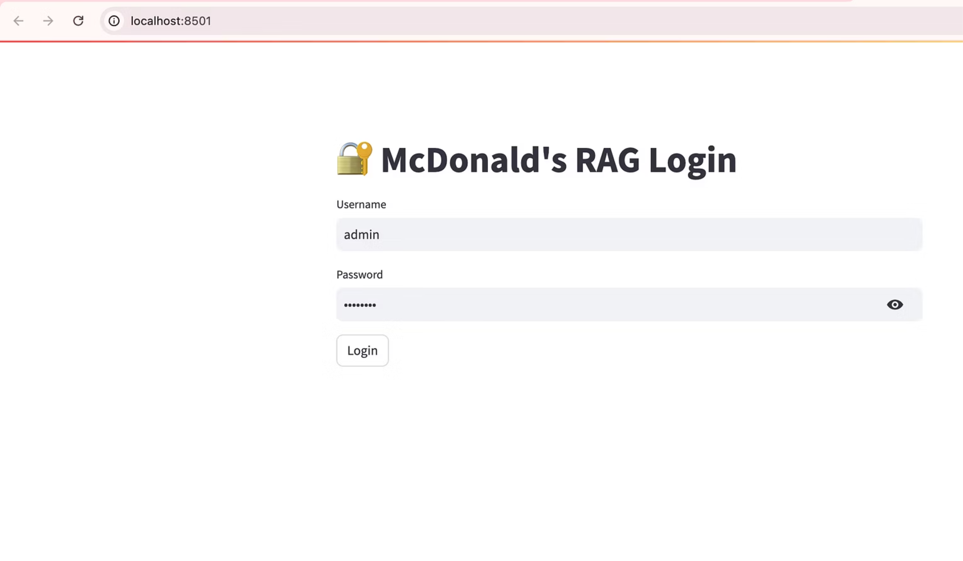
Login Page

Slide 9
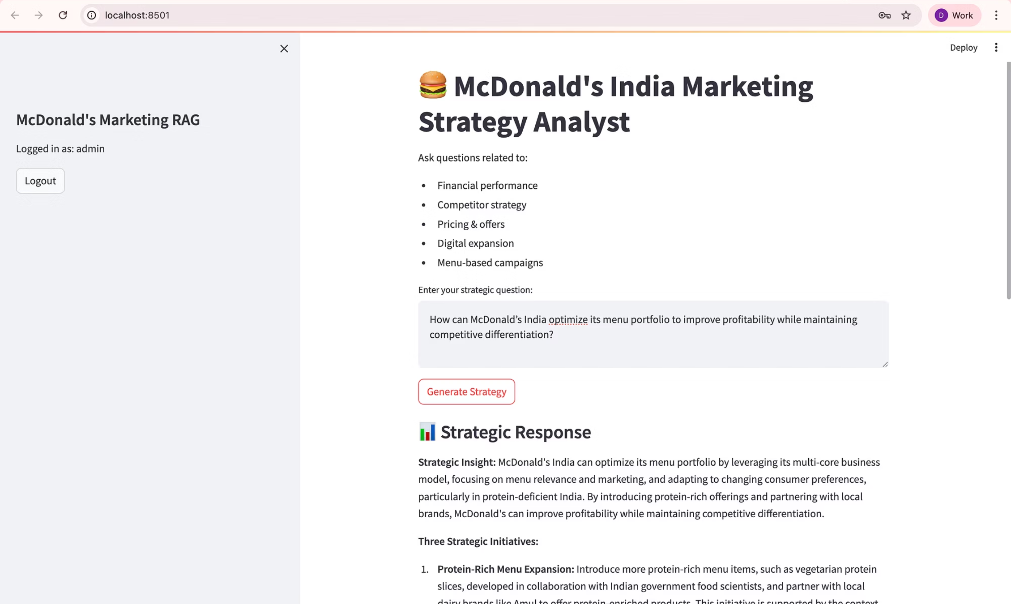
Query Page

Slide 10
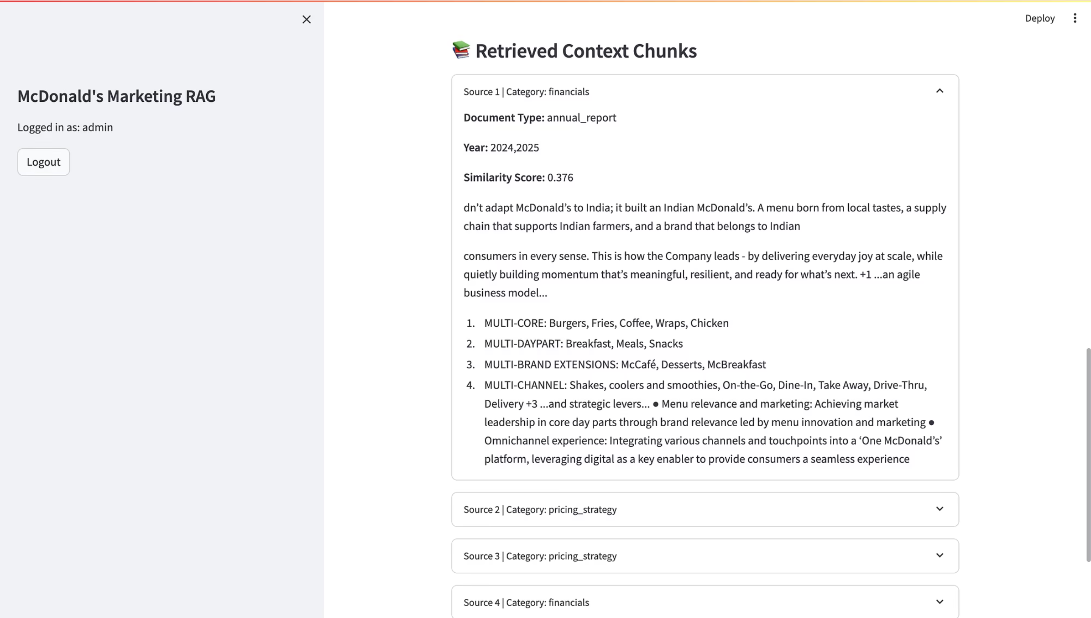
Retrieved Chunks

Slide 11


Thank You
Project Impact: This RAG system transforms how McDonald's India strategic teams access and utilise business intelligence, reducing insight generation time by 70% whilst improving decision quality through grounded, context-aware recommendations.

